Slide 1




Critical Thinking S1 2023
Dr. Iwan Williams
Email: iwan.williams1@monash.edu

Slide 2
Review Quiz!

Slide 3
Lesson 11.1:
Intellectual humility and cognitive biases

Slide 4
Two components of good critical thinking
Reasoning skills
Mindset
Representing Arguments
Evaluating Arguments
Scout
Soldier
3 Special Cases
Standard Form
Cognitive Biases
Validity
Truth
Informal fallacies
General Form
Deductive
Inductive
Generalisations
Map
Appeals to Authority

Slide 5
Two components of good critical thinking
Reasoning skills
Mindset
Representing Arguments
Evaluating Arguments
Scout
Soldier
3 Special Cases
Standard Form
Cognitive Biases
Validity
Truth
Informal fallacies
General Form
Deductive
Inductive
Generalisations
Map
Appeals to Authority
Notes:
Mindset: the attitudes, dispositions and habits with which we approach the project of updating our beliefs, evaluating evidence, and engaging with others.

Slide 6

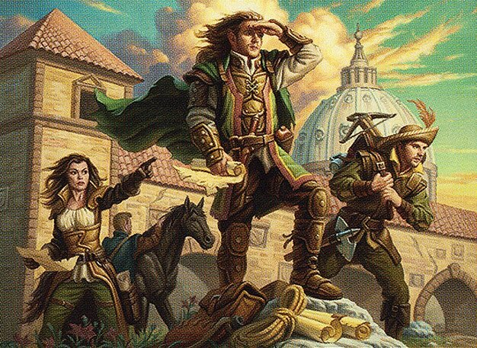
Soldier Mindset
Scout Mindset
Goal is to show that my beliefs are the right ones.
New information that challenges something I believe is seen as a threat to be neutralized.
Biased
Goal is to arrive at more accurate beliefs.
New information that challenges something I believe is seen as an opportunity to update my beliefs.
Unbiased

Slide 7
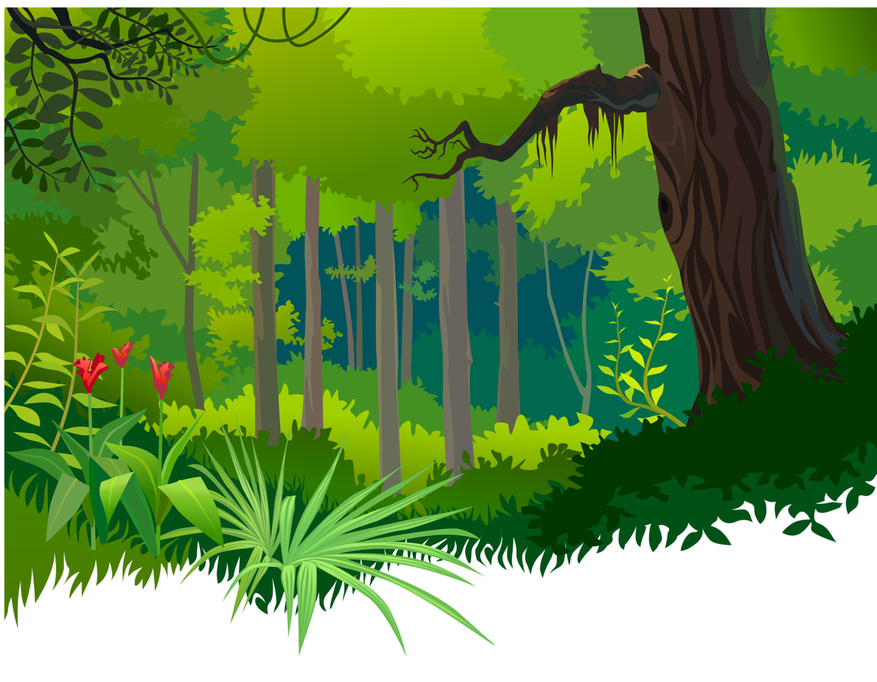
Outline: Three traits of good scouting
Intellectual Humility
Awareness of their own Cognitive Biases
Building Constructive Arguments

Slide 8
Perhaps the most important lesson: Intellectual humility
Realizing that you might be wrong & being open minded about different positions.
Admitting when you don’t know the answer
Being curious about your blind spots and limitations
Valuing opposing views and seeking them out
Accepting criticism and learning from failure
Revising your views in the face of contradicting evidence
Intellectual humility is a pre-condition for good critical thinking!

Slide 9

Wait a minute— isn’t humility an old-fashioned virtue?
Nope! It might even get you a job at Google!
Laszlo Bock, formerly in charge of hiring at google, considers intellectual humility as one of the top attributes successful candidates should have … because it’s a pre-requisite for fast learning.
(Thomas Friedman, How to get a job at Google, Feb. 22, 2014)

Slide 10
Intellectually humble doesn’t mean not having strong views!
Being intellectually humble means having:
Conviction in proportion to strength of evidence
Willingness to change you view in light of new evidence

Slide 11

Cultivating intellectual humility
Step 1: We need to change the way we think about being wrong.
… we need to learn how to feel proud instead of ashamed when we notice we might have been wrong about something. We need to learn how to feel intrigued instead of defensive when we encounter some information that contradicts our beliefs.
– Julia Galef

Slide 12
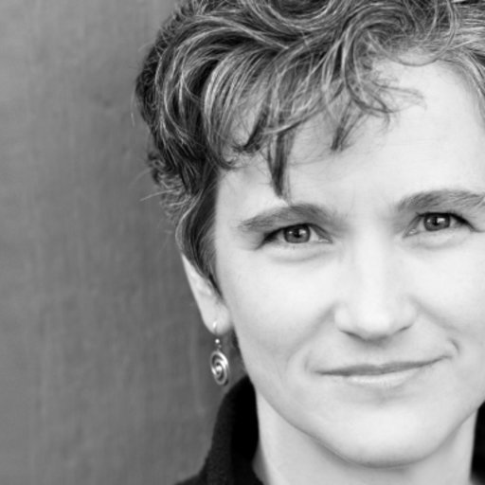
Cultivating intellectual humility
Step 2: We need to fine tune our understanding of our own biases. Without an understanding of our own biases we are prone to over-estimating the strength of our reasons.
It is not our biases that are our biggest stumbling block; rather it is our biased assumption that we are immune to bias. —Cynthia Frantz, 'I AM Being Fair’

Slide 13
Cognitive Biases

Slide 14
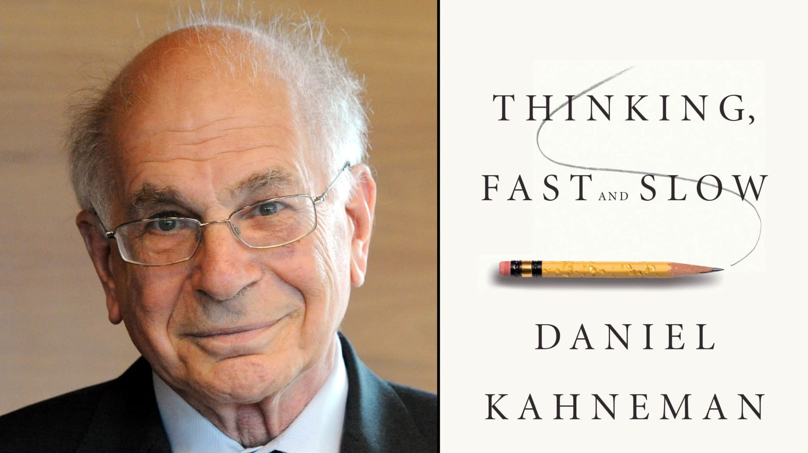
“A remarkable aspect of your mental life is that you are rarely stumped… The normal state of your mind is that you have intuitive feelings and opinions about almost everything that comes your way…. Whether you state them or not, you often have answers to questions that you do not completely understand, relying on evidence you can neither explain nor defend.”
(Daniel Kahneman, Thinking Fast and Slow, p. 96)

Slide 15
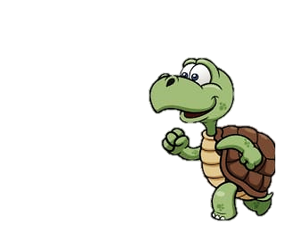
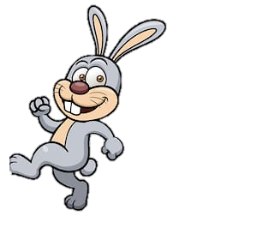
Two ways of thinking
system 1 (Intuition) /
System 2 (Reasoning)
Fast – automatic
Almost effortless
Unconscious
Always running
Implicit knowledge
Associative
Rough-and-ready
Evolved early / similar to other animals
Slow – voluntary control
Effortful – concentration
Conscious
Lazy, active only on demand
Explicit knowledge
Rule-based
Detailed
Evolved late / distinctively human?
Notes:
It’s not that system 1 is bad and system 2 is good. We couldn’t get by without the cognitive shortcuts that system 1 allows for.
But note that biases often come into play when we rely on system 1 style thinking (our ”gut feelings”) rather than engaging system 2.

Slide 16
What is a cognitive bias?
A cognitive bias is a systematic error in thinking often due to implicit psychological shortcuts.
Examples:
Motivated reasoning
Confirmation bias
Availability heuristic
Ingroup bias

Slide 17
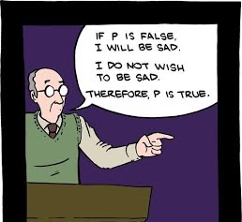
Motivated Reasoning
Forming or maintaining a belief at least partly because, at some level, we want it to be true.
94% of college professors thought they did "above-average work“ (Cross 1977).
93% of American drivers rated themselves better than the median driver (Svenson 1981).

Slide 18
Confirmation Bias
The tendency to notice or focus on potential evidence for our pre-existing views, and to neglect or discount contrary evidence.
Confirmation bias can be present without an underlying motive to have the belief in the first place.
David Manley – Reason Better
Notes:
Unlike motivated reasoning…

Slide 19
Are these arguments valid?
1. Anything made of wood can be used as fuel.
2. Petrol is not made of wood.
Therefore,
C. Petrol cannot be used as fuel.
1. All African countries are hot.
2. Antarctica is not an African country.
Therefore,
C. Antarctica is not hot.
Notes:
Illusion of validity: when we already know the conclusion to be true, we easily overlook that the reasons given in its support are invalid
The slow and deliberate reasoning system never kicks in because we intuitively seem to know the answer
If we already believe the conclusion to be true, we are far less critical of the reasons being given to support it than if we think the conclusion is false.
What’s more, we aren’t aware that we are doing this!!! So reminding oneself to ‘be objective and fair’ is not effective!

Slide 20
Neither!
1. Anything made of wood can be used as fuel.
2. Petrol is not made of wood.
Therefore,
C. Petrol cannot be used as fuel.
1. All African countries are hot.
2. Antarctica is not an African country.
Therefore,
C. Antarctica is not hot.
Illusion of validity: when we already know the conclusion to be true, we easily overlook that the reasons given in its support are invalid
The slow and deliberate reasoning system never kicks in because we intuitively seem to know the answer
Notes:
Illusion of validity: when we already know the conclusion to be true, we easily overlook that the reasons given in its support are invalid
The slow and deliberate reasoning system never kicks in because we intuitively seem to know the answer
If we already believe the conclusion to be true, we are far less critical of the reasons being given to support it than if we think the conclusion is false.
What’s more, we aren’t aware that we are doing this!!! So reminding oneself to ‘be objective and fair’ is not effective!

Slide 21
Availability heuristic
The availability bias is the tendency to think that the examples that easily come to mind are more representative than is actually the case.
Notes:
We discussed this in week 7

Slide 22
What animal kills the greatest number of people?

Slide 23
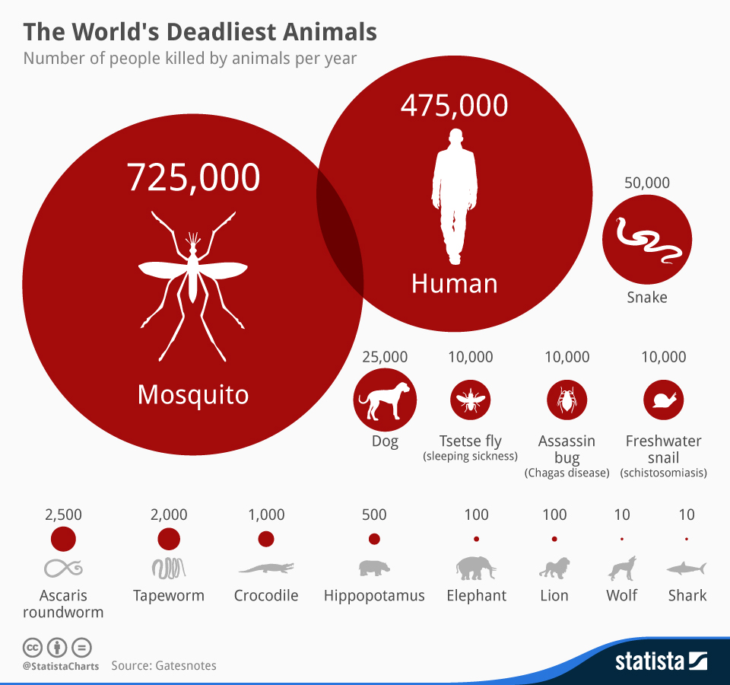

Slide 24
Availability to memory is skewed by irrelevant factors:
intensity of emotion
framing of question
order effects
media biases

Slide 25
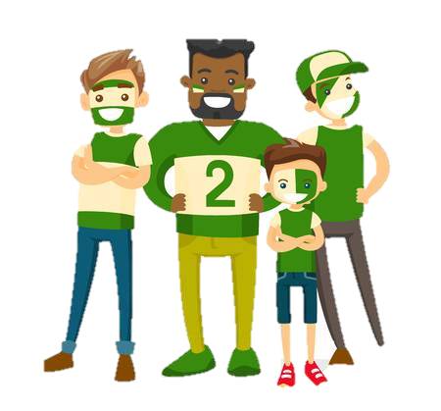



In-Group Bias
We have more empathy for people we perceive to be like us (in-group).
What counts as an in group?

Slide 26
Combatting Cognitive Biases
Tip 1: Acquaint yourself with your own biases!
Tip 2: Considering the opposite. Ask yourself:
How would I react to this evidence if I believed the opposite? (Babcock, Loewenstein, & Issacharoff 1997)
How would I react to this evidence if it showed my belief to be false? (Lord, Lepper, & Preston 1985)

Slide 27
Lesson 11.2:
Constructing your own arguments

Slide 28


Building Constructive Arguments

Slide 29
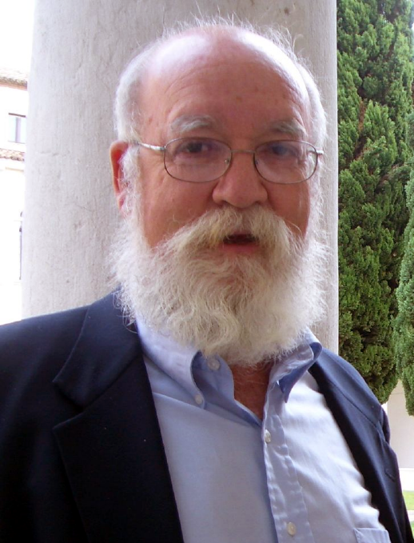

Charity
“1. You should attempt to re-express your target’s position so clearly, vividly, and fairly that your target says, “Thanks, I wish I’d thought of putting it that way.”
2. You should list any points of agreement (especially if they are not matters of general or widespread agreement).
3. You should mention anything you have learned from your target.
4. Only then are you permitted to say so much as a word of rebuttal or criticism.”
Notes:
On building a critical commentary, but note that this applies to any discussion / reconstruction of another person‘s claim or argument

Slide 30




Building your argument: Where do you stand?
Beware!
Implicit assumptions and biases can corrupt our judgment and decision-making in various ways.
What do you think?
Try to make it explicit.
I have a bad feeling about the exam. I don‘t think I did very well.
Why do you think this?
Is this a typical view for you to take, like a cognitive habit? Is it well founded?
Well, I did study and I was able to answer all of the questions. And I do tend to think I did badly and then my marks are ok.
What would make you change your mind?
Can‘t think of anything? Might be an indication that you don‘t have such good reasons!
Hm.... Given the evidence so far, I should probably stop worrying!

Slide 31

Building your argument: Transparency
Put your cards on the table!
Use signposting and be explicit about your assumptions (including assumptions for the sake of argument).
Embrace spoiler messages! If your audience knows from the beginning what you are arguing for, and how, then they can assess your argument as it unfolds.
Don‘t overstate your case. Be honest about how strong the evidence is in support of your premises (use references properly!) and how they support the conclusion.
Acknowledge the limitations of your argument and any objections
If relevant, be open about your background (any conflict of interest, personal motivation, bias?)

Slide 32

Building your argument: Clarity
Aim to persuade through evidence and reasons.
This is best achieved through simplicity and clarity (use simple clear language, minimize jargon, consider using argument maps or standardizing your argument).
Define your terms, avoid sloppy language and equivocation.

Slide 33

Building your argument: Quantity
Grice’s Maxim of Quantity
Give as much information as is needed, and no more. Don’t include irrelevant information and avoid redundancy.
Consider your audience
How much background knowledge do they have? Which claims and concepts might need clarification, which might be controversial?

Slide 34
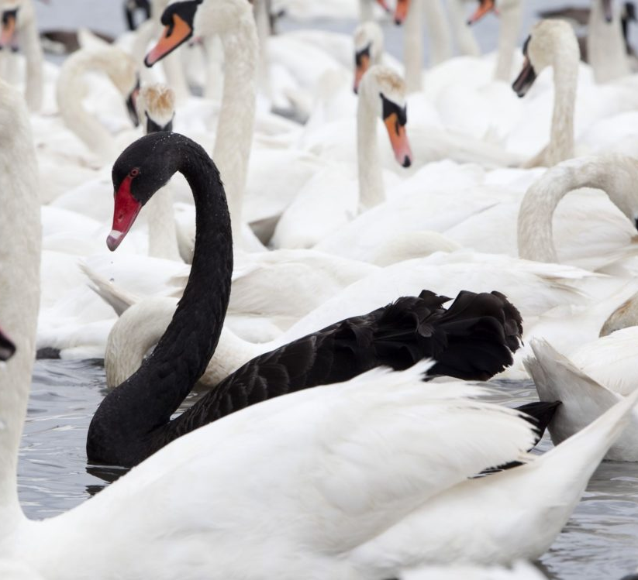
Testing your argument: seek out evidence that contradicts your view
“All swans are white!”
Looking for more white swans won’t help show that the claim is true.
Observing a single black swan will show that the claim is false.
So looking for non-white swans is the best way to test your hypothesis / claim.

Slide 35
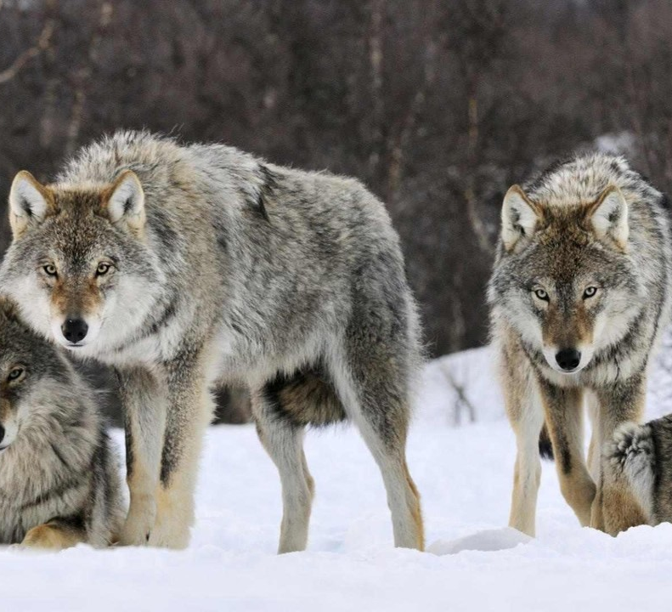
Testing your argument: Find an intellectual community
Don’t be a lone wolf!
Argument development in all stages profits from conversation and debates.
Just as you should seek out evidence that could disprove your claim, seek out the opinions of people that disagree with you. That’s more useful than talking to people who agree.
Even if you already consider counter-examples and objections to your claims, other people will offer different perspectives, raise new questions (about assumptions, definitions), and help you see familiar issues in a new light.
Taking other people’s comments and questions on board will improve your argument as you reformulate your claims.

Slide 36

Revising your argument
Intellectual Humility is about Intellectual Growth
Be open to revising or even changing your position.
Remember that your conclusions are only as good as the reasons you have to believe them.
What might seem like a strong, well supported claim at one point might be disproved at a later point when new reasons or evidence come up.
So revising your position should never be off the table.

Slide 37

Next Week:
Revision

